Slide 1
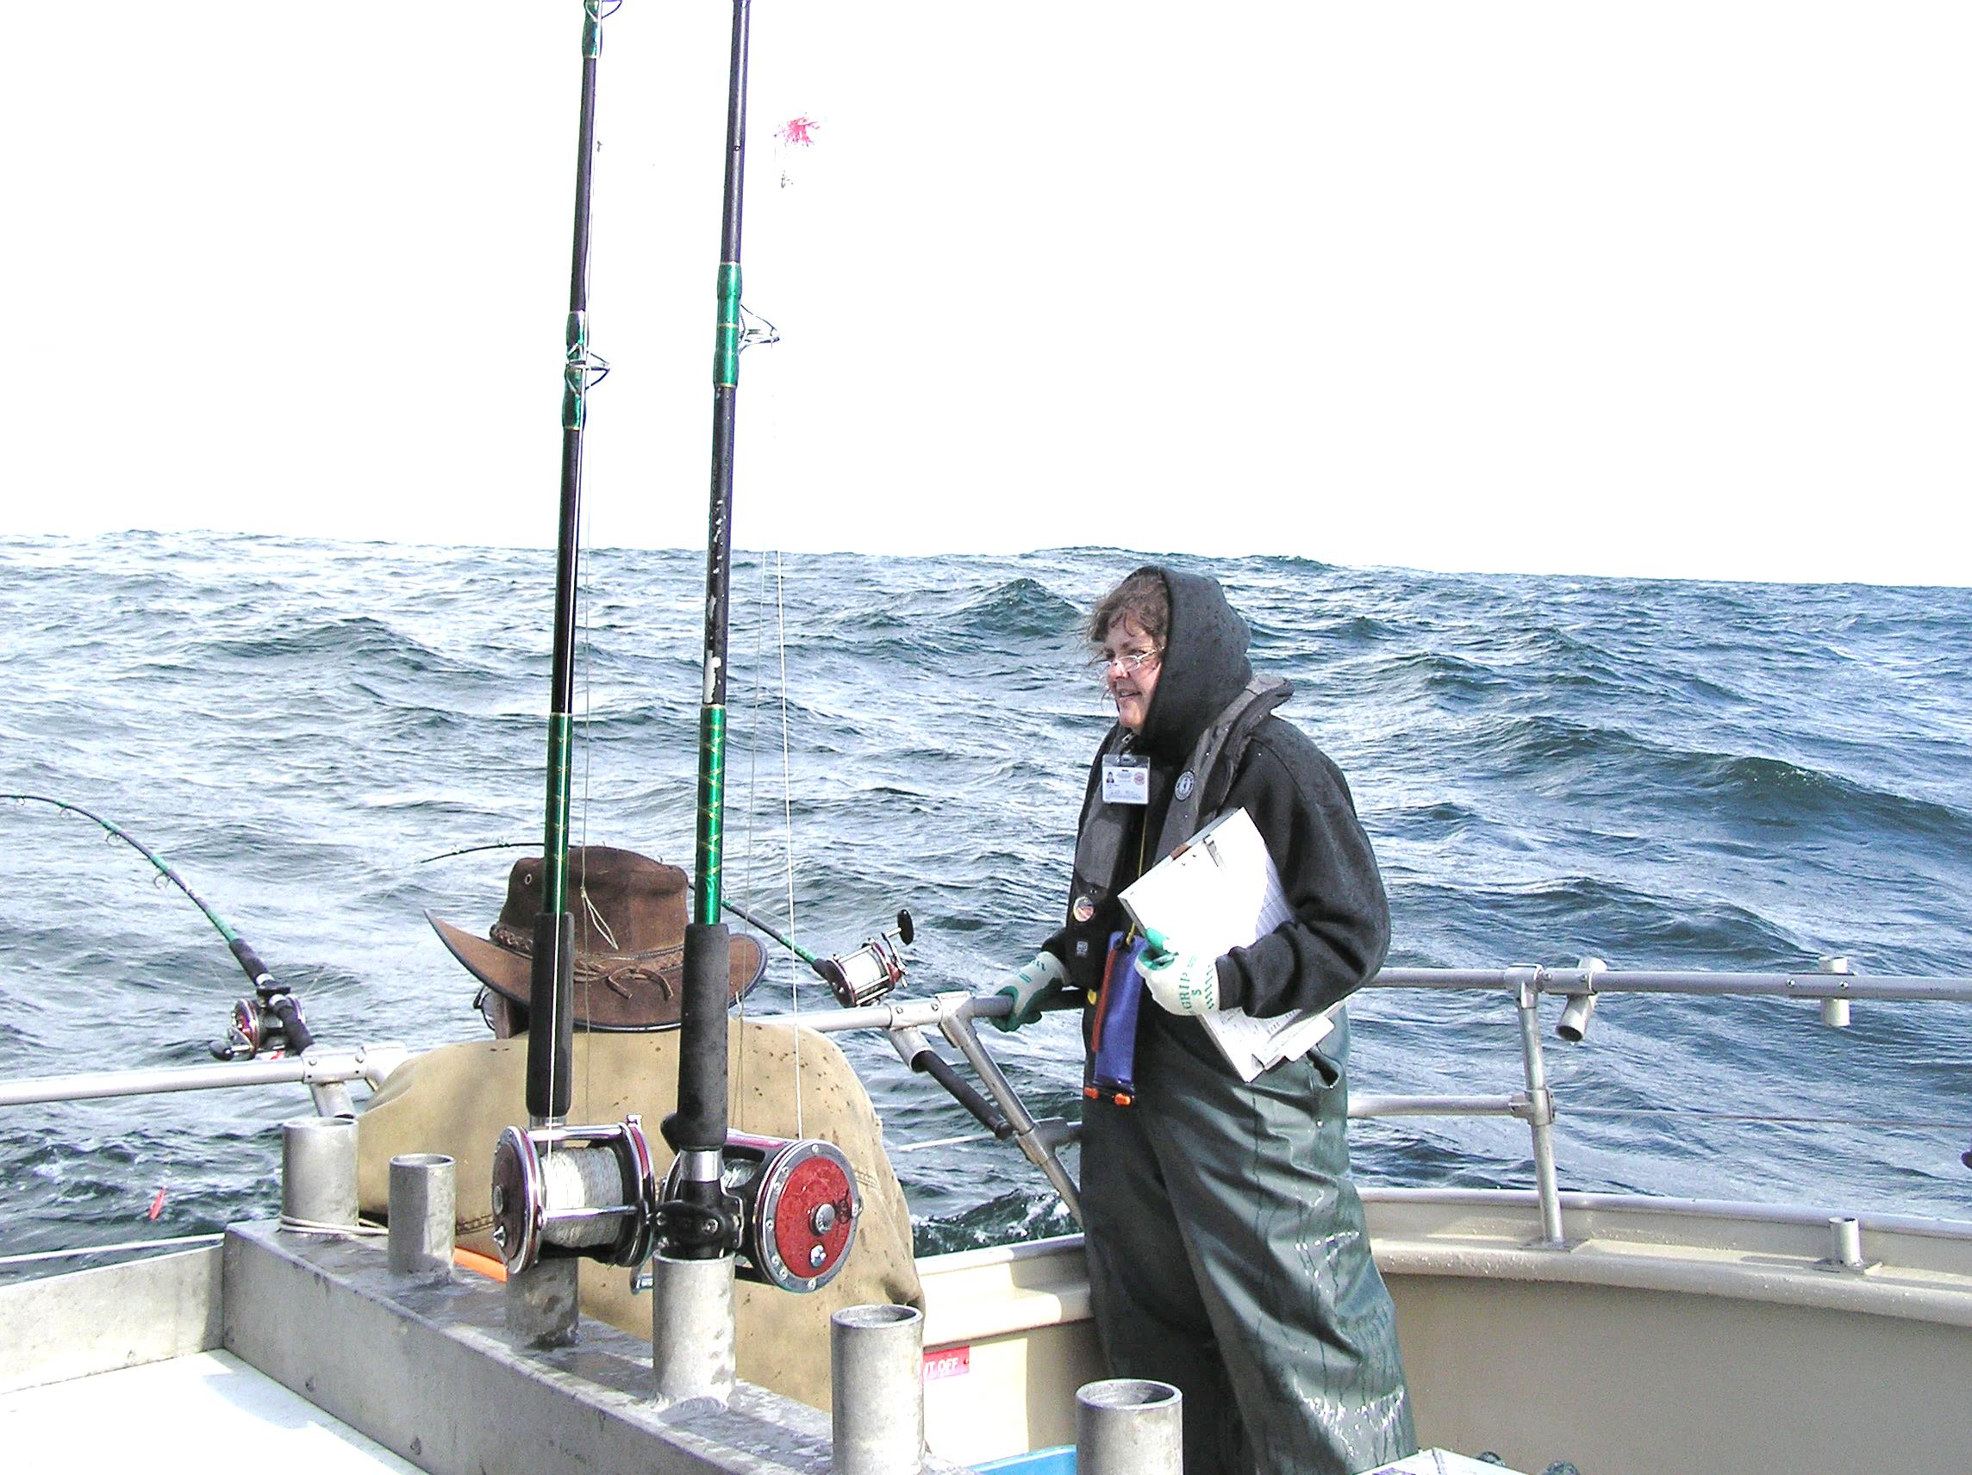
Oregon At-Sea Data Collection
Notes:
Sport groundfish. That’s Sheila sampling with an old clipboard.

Slide 2
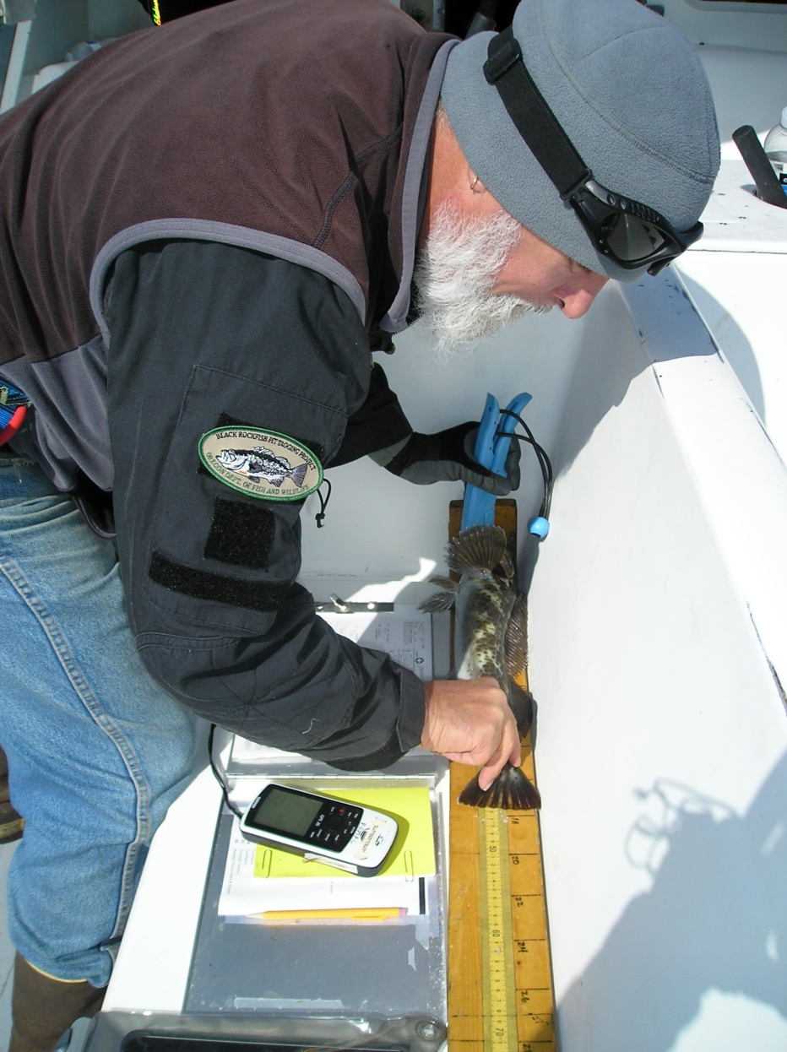
What At-Sea Sampling Gets Us
Reliable release information (species, size and count)
Spatially-explicit information (species composition, catch rates, fish size)
Data from prohibited species (Yelloweye Rockfish)

Slide 3
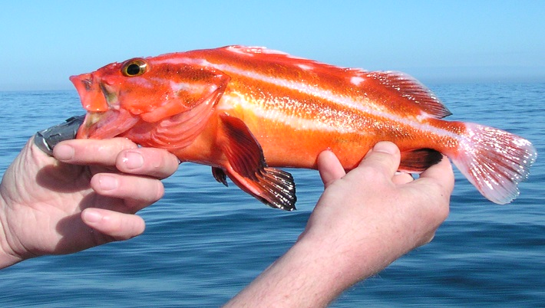
Data are used to
Estimate total removals
Describe geographic areas of fishing
Inform stock assessments and trends

Slide 4
Scope of Project
About 95 sport bottomfish trips each year, or 2.5% of trips out of sampled ports
Three samplers cover seven ports
About 34 different charter (head) boats participate; a handful (about 4) refuse.
Notes:
Only bottomfish trips are sampled.
Other boats are not sampled due to limited deck space or limited number of trips.
Six boats that take samplers do not allow GPS data to be collected.
Sampling rate 2.5% of bottomfish charter trips in sampled ports.
Sampling period is March-October.

Slide 5
How Many Discards Do We Sample?
Notes:
Sampled fish are from a subsample (usually 4-5 anglers/drift) of all anglers.

Slide 6
From Discards We Record
Species
Length
Release method
Sex (from Lingcod and Kelp Greenling only)
Notes:
Release methods = surface (tossed overboard), with a device, or dead (e.g. heavy bleeding).
We don’t weigh discards – too stressful on fish.

Slide 7
The Setup
iPad Air 2
Custom app (iOS)
LifeProof case
Measuring board
A SQL database
Wireless flash drive
Notes:
The benefits of the app are expected to be improved data quality, sampling efficiency, and data accessibility.
The intended outcome is a successful system of electronic data collection at sea that can be expanded to other observer programs.

Slide 8
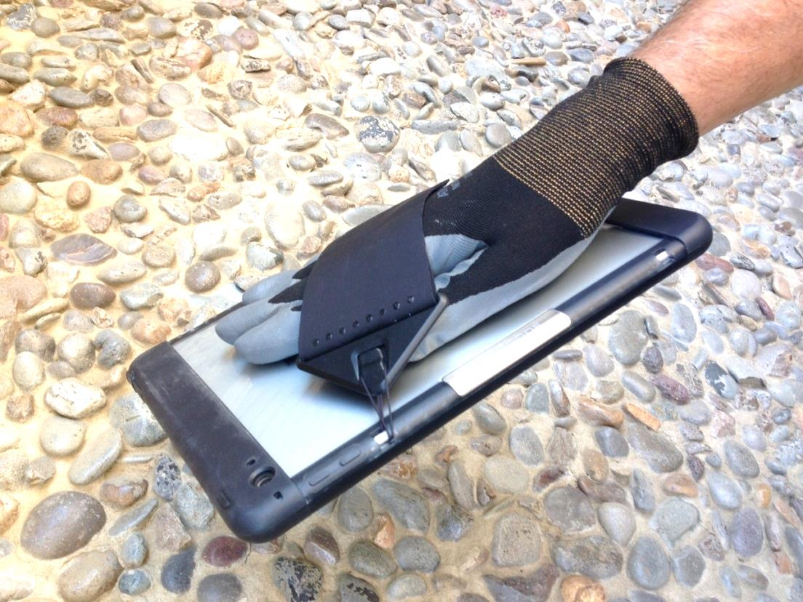
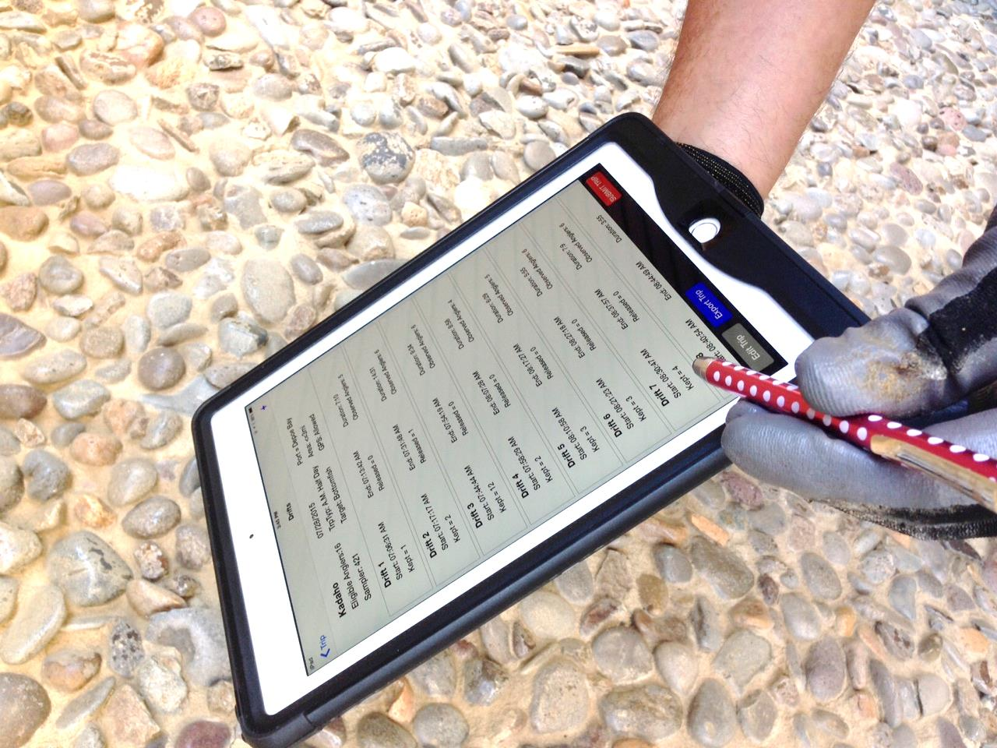
Notes:
Hand strap used to hold onto unit. Tablet can readily be set down on table. Stylus used because of gloves.

Slide 9
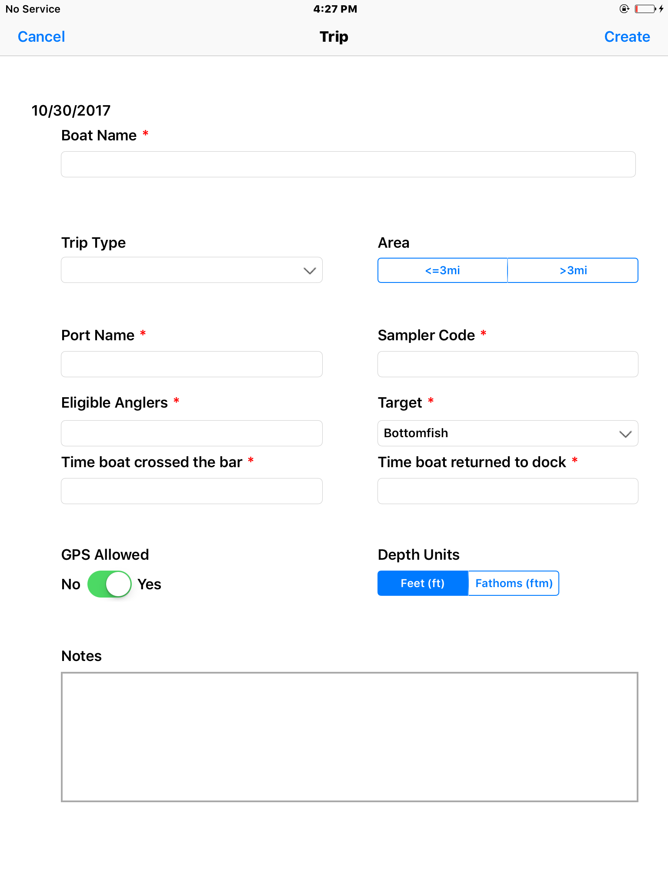
Create a Trip
Notes:
Red circles indicate pull-downs and toggle boxes

Slide 10
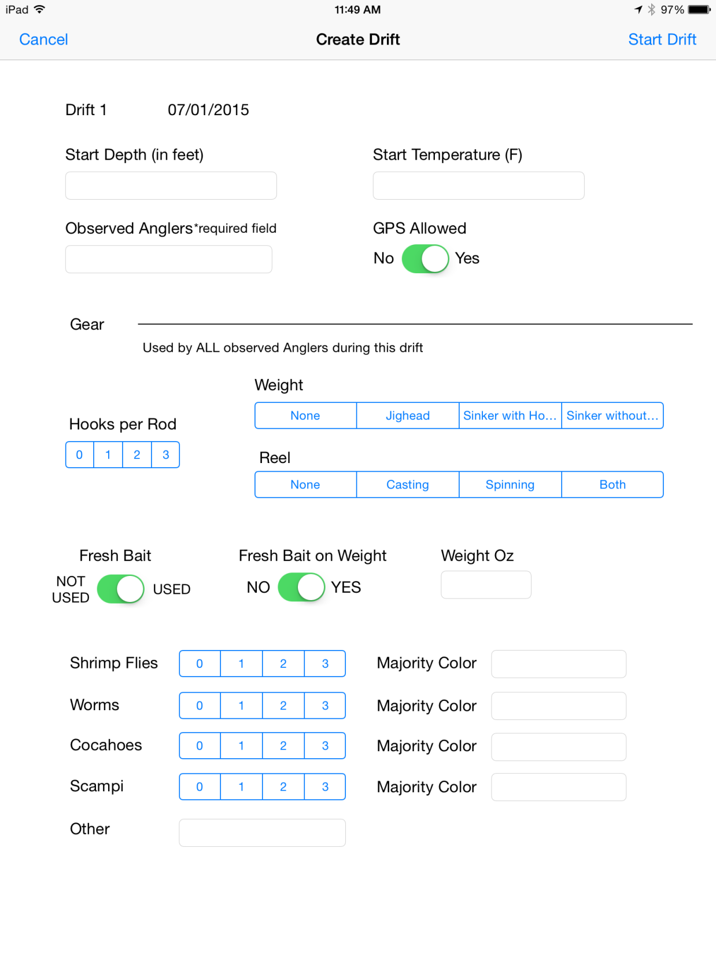
Create a Drift
Notes:
GPS can be turned off for a specific drift if captain asks.

Slide 11
Tally Kept Fish
Notes:
Pull-down species list when typing starts.
GPS coords. are visible

Slide 12
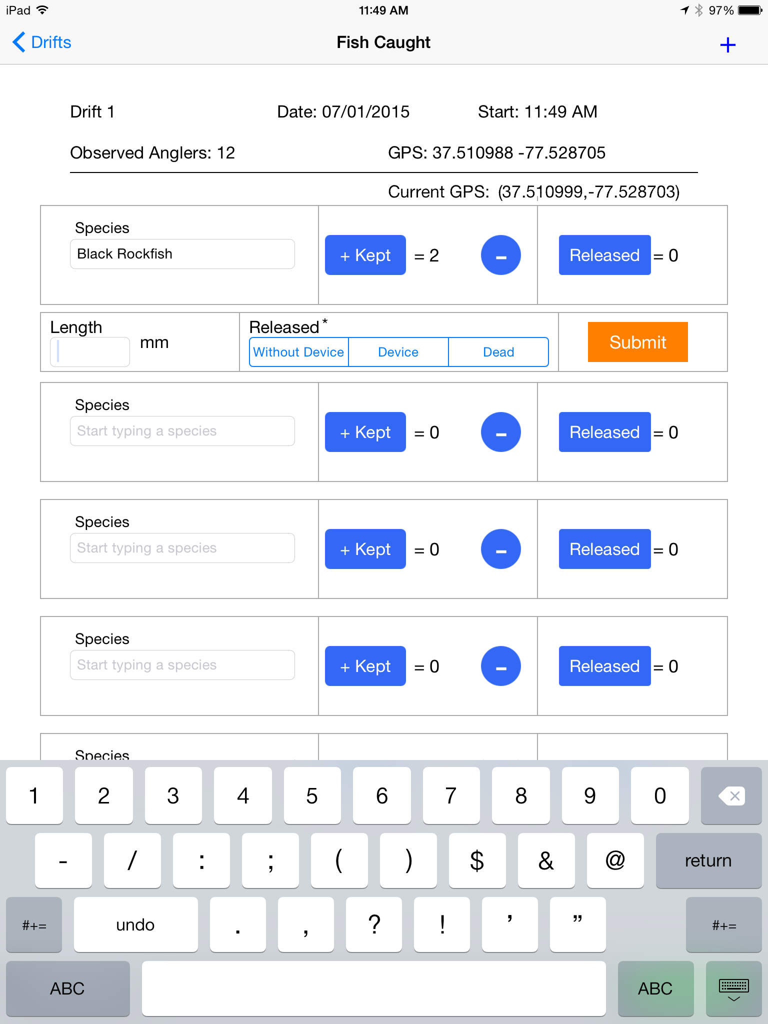
Record Released Fish
Notes:
When a released fish is tallied, relevant data fields pop up; then go away.

Slide 13
Notes:
What the fish caught screen looks like after awhile. Still on drift (stop) 1

Slide 14
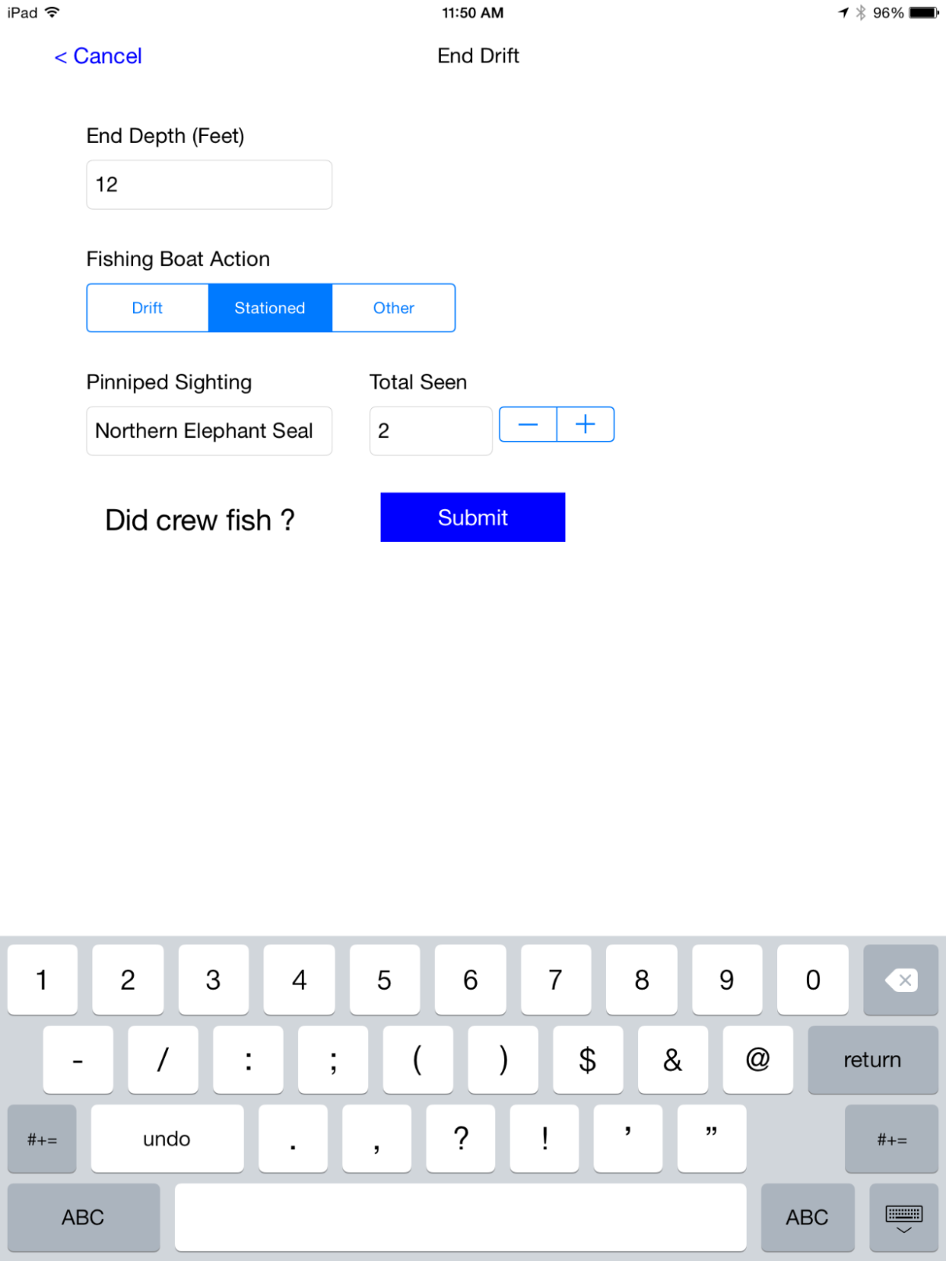
End the Drift
Notes:
observed pinnipeds can be entered.

Slide 15
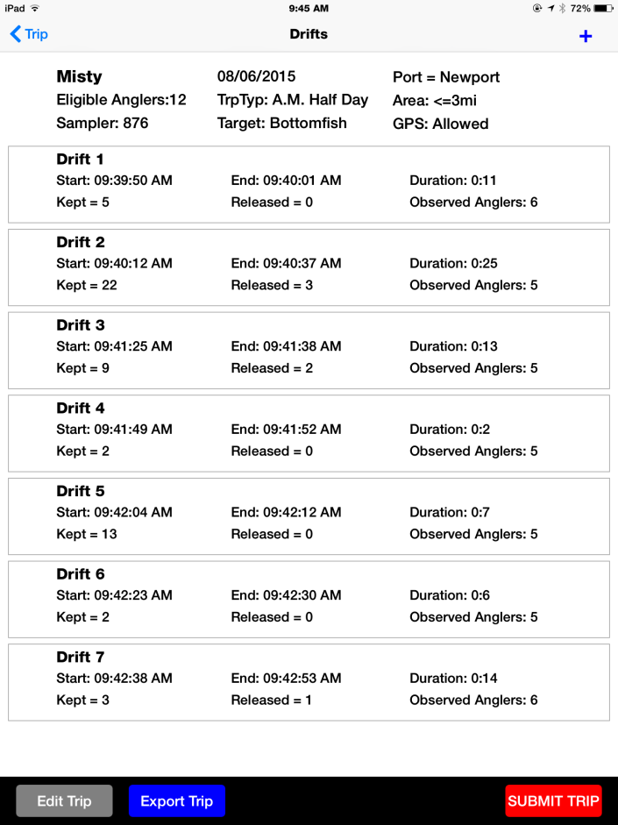
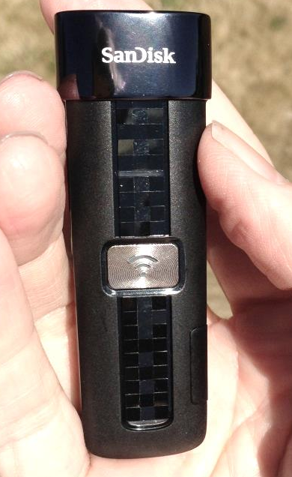
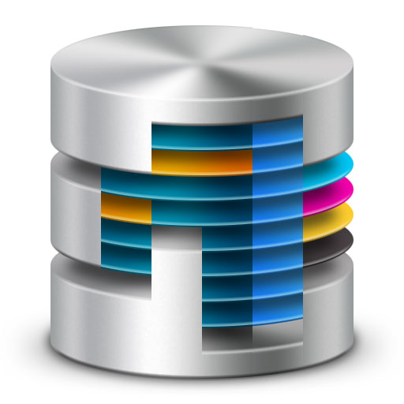
Upload the Data
RecFIN server
Notes:
Wireless flash drive = backup system.
After trip is submitted to PSMFC dbase, trip data are wiped from tablet.

